Slide 1

Atliq Hospitality Analysis
Presented by Margarat Sheeba

Slide 2

Agenda
Recommendations
Data‑driven ideas
Growth opportunities
Strategy decisions
Charts & Insights
Trend analysis
Customer insights
Sales analysis
Dashboard
Interactive dashboard
Visual filters
Overview insights
KPIs
Define indicators
Sales metrics
Business performance
Data Model
Data cleaning
Table relationships
Data transformation
Company Overview
Intro to company
Business domain
Dataset sources

Slide 3
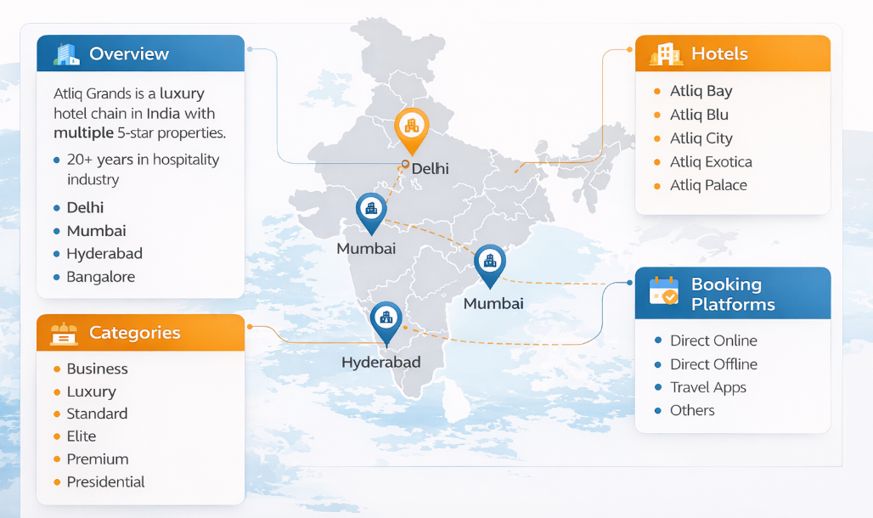
Company Overview

Slide 4
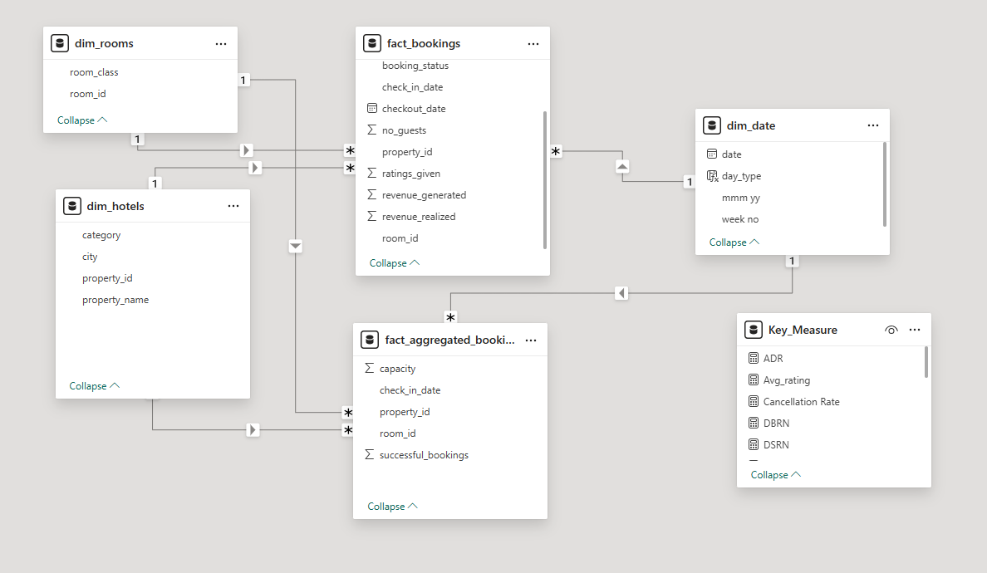
Data Model
Star Schema

Slide 5
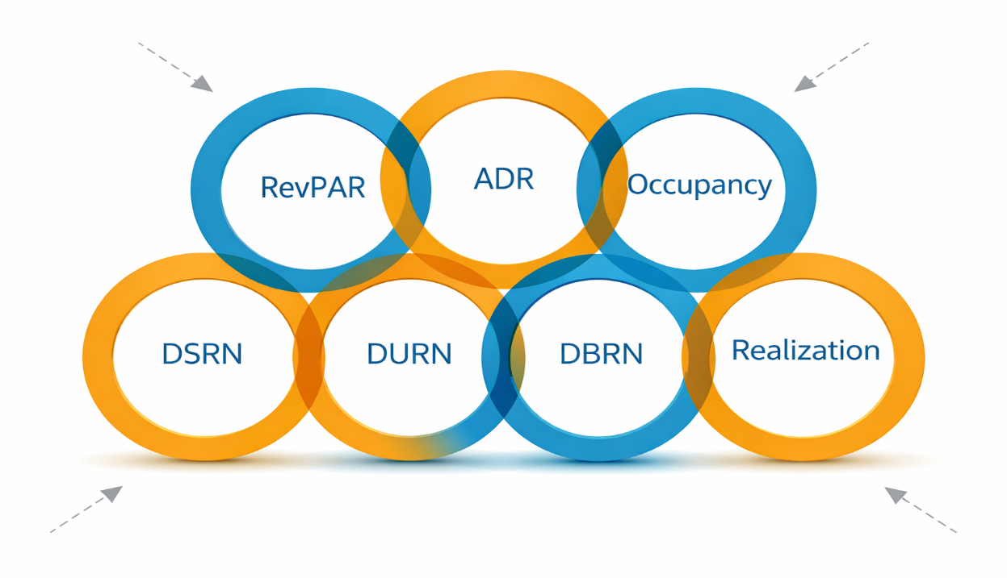
Key Performance Indicators
Hospitality Domain
RevPAR (Revenue Per Available Room) = Total Revenue / Total Rooms Available to Sell
ADR (Average Daily Rate) = Total Rooms Revenue/ No. of Rooms Sold
Occupancy %=
Total Rooms Occupied/ Total Rooms Available
DSRN - Daily Sellable Room Nights
Realization = DURN/DBRN
DURN- Daily Utilized Room Nights
DBRN (Daily Booked Room Nights) = DURN + No Show + Cancellation

Slide 6
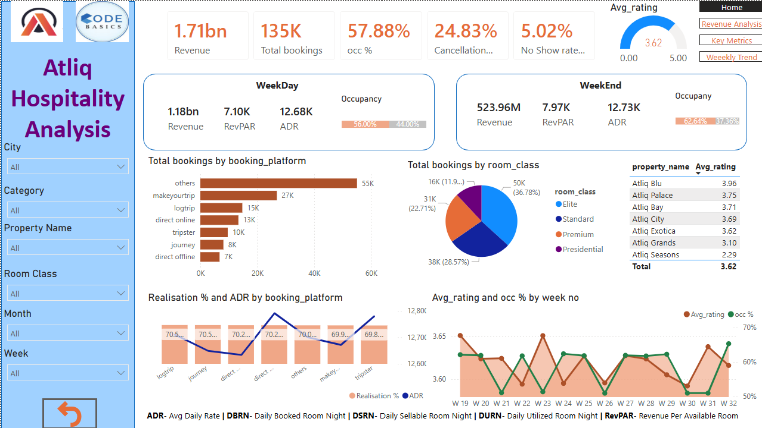
Dashboard

Slide 7
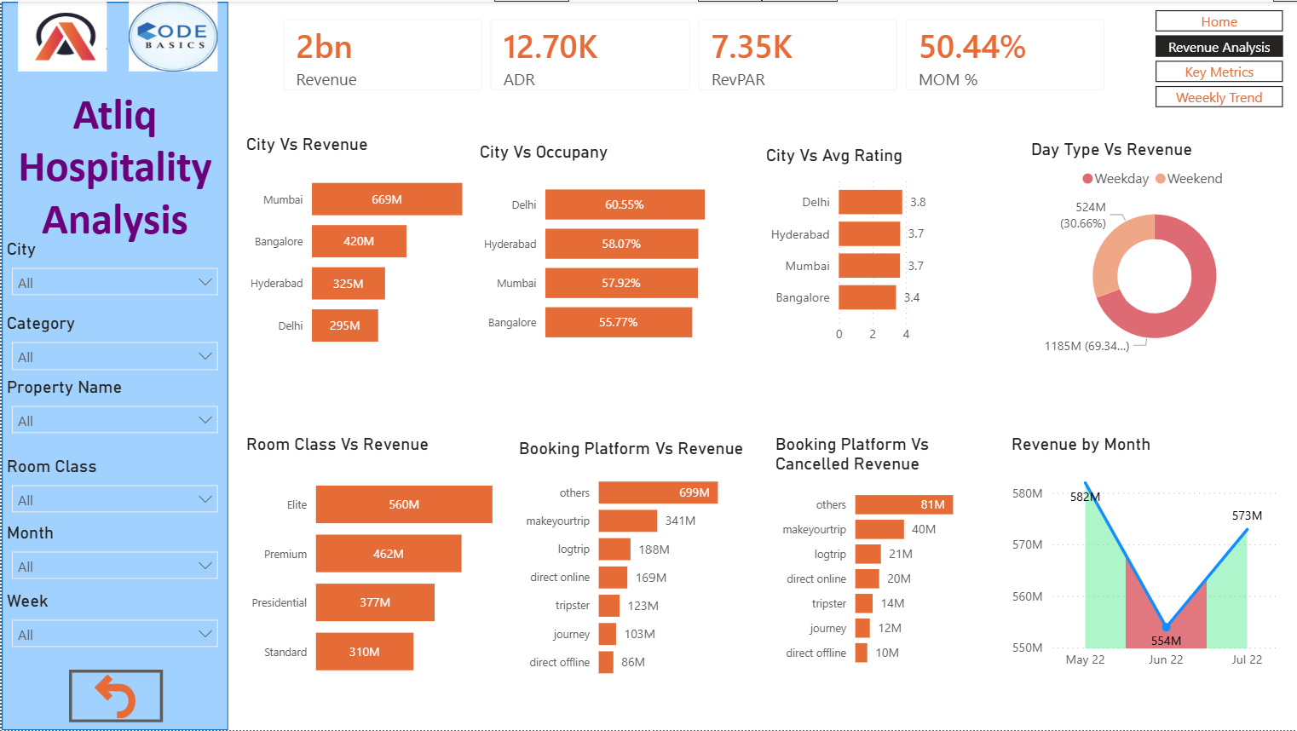
Dashboard

Slide 8
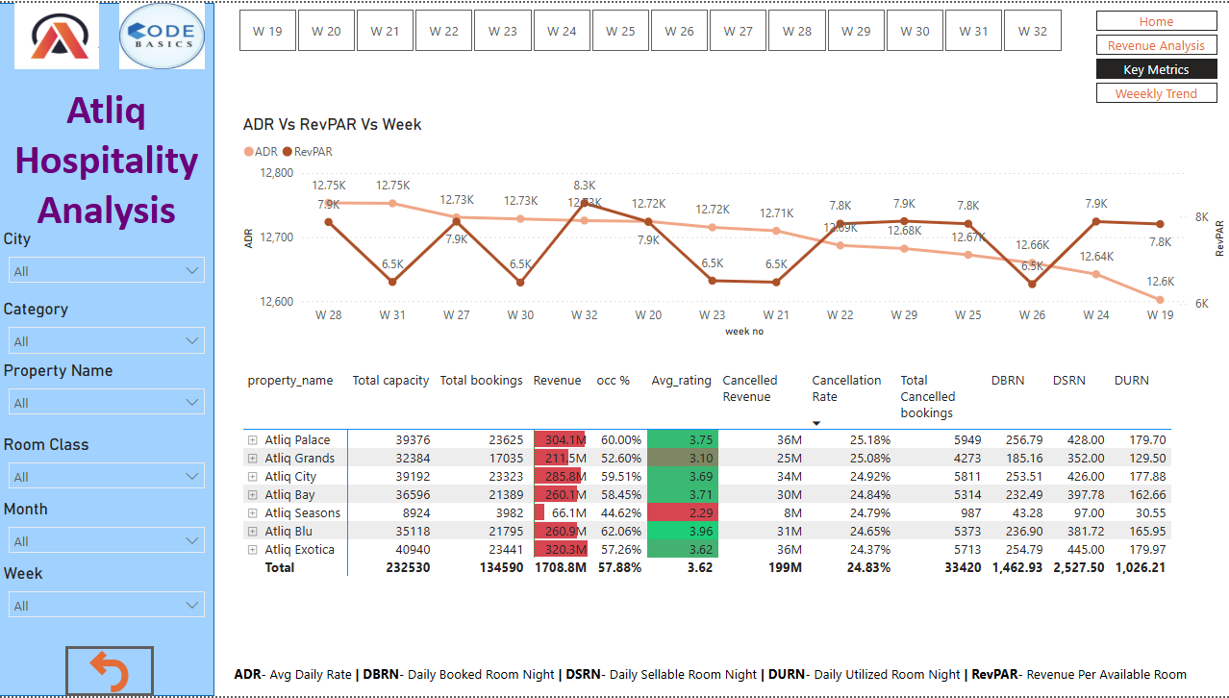
Dashboard

Slide 9
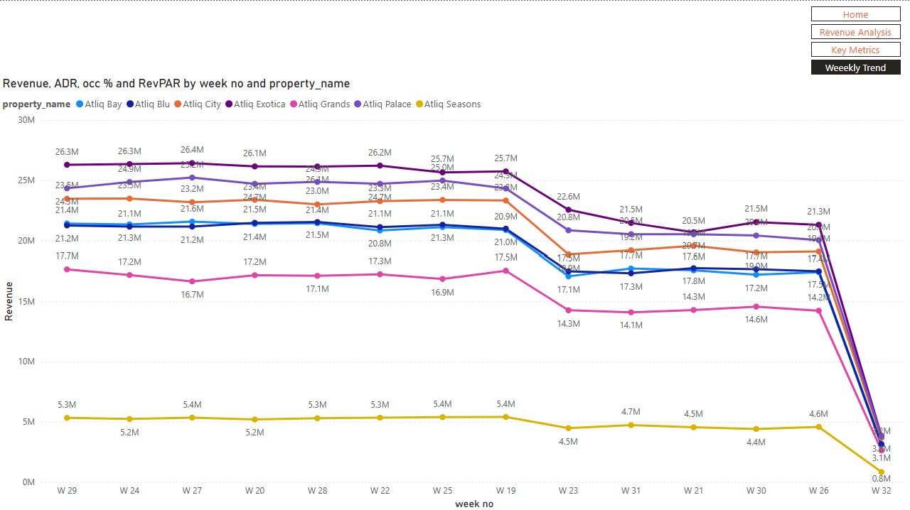
Dashboard

Slide 10
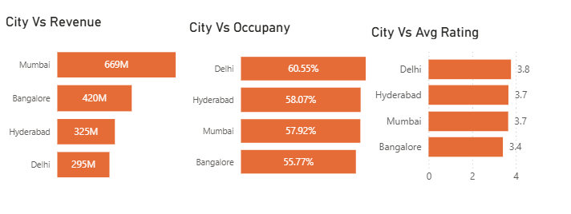
Insights
City-wise Ranking
Mumbai leads in revenue generation at 669
million (39.13%), followed by Bangalore (24.6%),
Hyderabad (19.03%), and Delhi (17.23%).
Delhi emerges as the top-performing city in both
Occupancy % and Average Rating.
Following closely behind is Hyderabad, Mumbai and Bangalore also demonstrate strong performance

Slide 11
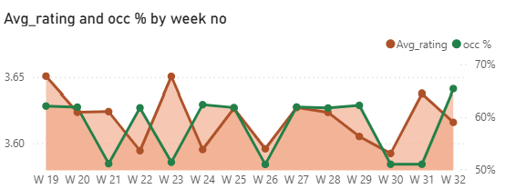
Insights
In the analysis of Atliq Hotels performance in India for weeks 19 to 32 of 2022, certain trends stand out.
Week 32 (August 14 - August 20, 2022) shows a high occupancy rate of 65.3%, indicating high demand.
Week 26 (July 03 - July 09, 2022) and week 31 (August 07 - August 13, 2022) see lower occupancy rates at 51%.
Week 23 (June 12 - June 18, 2022) shines with a high average rating of 3.65,
while week 22 (June 05 - June 11, 2022) and week 30 (July 31 - August 06, 2022) show slightly lower ratings at 3.51.

Slide 12
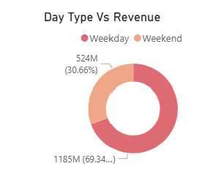
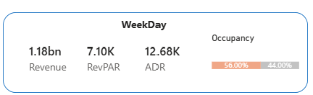
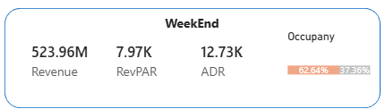
Insights
During weekdays, the revenue totals 1185 million rupees, representing 69.34% of the total revenue.
Occupancy stands at 55.99%, with an Average Daily Rate (ADR) of 12,683.18 rupees and Revenue per Available Room (RevPAR) of 7.10 thousand rupees.
Atliq Exotica Hotel leads in revenue with 222 million rupees, while Mumbai alone contributes 147M rupees. On the other hand, Atliq Seasons records a comparatively lower revenue of 46M rupees during weekdays.
During weekends see a revenue of 524 million rupees, constituting 30.66% of the total revenue.
Occupancy increases to 62.64%, accompanied by a slightly higher ADR of 12,725.49 rupees and an improved RevPAR of 7.97 thousand rupees.
Atliq Exotica maintains its high revenue status with 98M, while Atliq Seasons generates 20M, surpassing other hotels during weekends

Slide 13
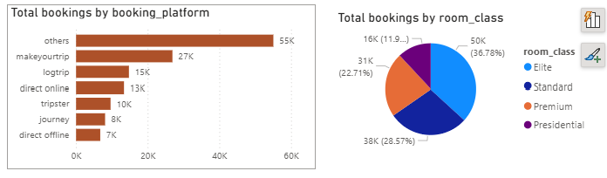
Insights
Direct offline bookings indicate a lower count and ratings by 8.1K (6.02%), whereas bookings through other platforms showcase higher ratings.
Notably, bookings via MakeYourTrip account are 19.9% of the total.
Among room types, Elite rooms secure the highest number of bookings, comprising 50K (36.78%).
Following Elite rooms are Standard rooms at 28.57%, Premium rooms at 22.71%, and Presidential rooms at 11.94%.

Slide 14
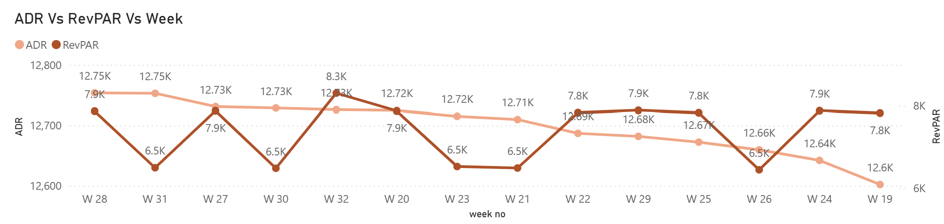
Insights
During weeks 19 to 32, W32 (Aug 14 - Aug 20, 2022) sees the highest RevPAR at 8.31K,
with W21 (May 22 - May 28, 2022) and W30 (July 31 - Aug 06, 2022) showing lower values at 6.49K.
W28 (July 10 - July 16, 2022) and W31 (Aug 07 - Aug 13, 2022) exhibit high ADR at 12.75K,
while W19 (May 01 - May 07, 2022) shows a slightly lower ADR at 12.60K.
In W32, Atliq Seasons impresses with an ADR of 17.32K, while Atliq Palace achieves the highest RevPAR of 8.85K, the highest among all hotels during this period.

Slide 15
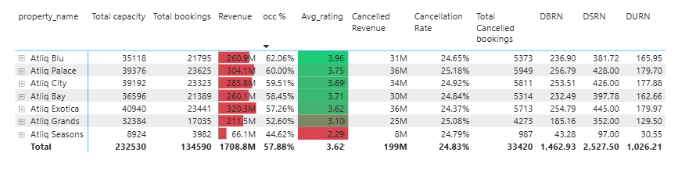
Insights
AtliQ Blu has the highest occupancy rate at 62%, highlighting significant demand for this property.
While, Atliq Seasons records the lowest occupancy rate at 44.62%, indicating potential areas for improvement.
In terms of cancellations, Atliq Palace experiences the highest rate at 25.18%, closely followed by Atliq Grands and Atliq City.
Whereas, Atliq Exotica registers the lowest cancellation rate at 24.37%.
The cancellations incurred by AtliQ resulted in a substantial loss of approximately 200 million, underscoring the financial impact of booking cancellations on the business.

Slide 16
Recommendations
💡 1. Enhance Customer Experience
🏨 2. Property-Specific Strategy
🚀 3. Scale High Performers
Staff training & service quality improvement
Faster response time
Regular cleanliness & maintenance audits
👉 Impact: Improves Ratings → Occupancy → Revenue
🔴 Atliq Seasons
Rebranding / renovation
Improve service standards
Revisit pricing strategy
🔴 Exotica Hyderabad
Benchmark with top-performing Exotica properties
Identify and fix operational gaps
Expand presence in Mumbai
Replicate best practices from Atliq Blu

Slide 17
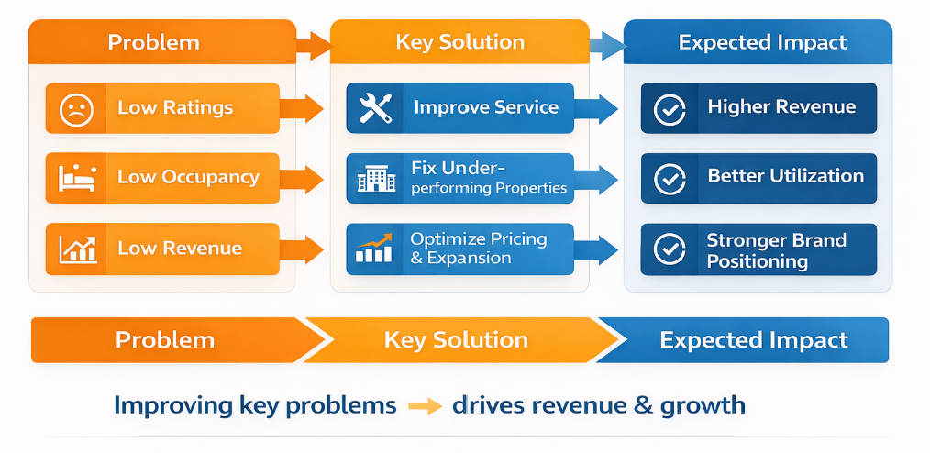
Business Impacts

Slide 18
Thank You
Margarat Sheeba

